Slide 1


Group Project Submission Template
Due Friday, March 28th at 1:00pm

Slide 2
INTRODUCTION
as a data analyst Ayiti Analytics Data wishes to extend its training centers to all the communes of the country. he contacted us and asked us to help them realize this dream. while taking into account the last cohort that took place in Port-au-Prince

Slide 3
Problem
The problem is that Ayiti Analytics Data wants to extend its training centers to all the communes of the country.
The goal is to find out which three communes in the country will be the most likely to expand its training centers. Since the objective of Ayiti Analytics is to train young people in the field of technology, not finding a suitable community could affect the Ayiti Analytics team in the sense that if they do not find a population that does not really correspond or meet their expectations, the team will not be able to really achieve its objectives, which could lead to a loss, and this loss could be related to specific skills, resources.
or because of the students' abandonment.
This problem will be of great magnitude for the Ayiti Analytics team as they might not get the desired percentage of girls for each on average or the total number of students, and this dropout will also be very loss making for them as they had already paid to join the 3rd cohort and will have missed the opportunity to find a job and a privileged access to a scarce resource (data science) which loss can be linked to specific skills, resources.

Slide 4
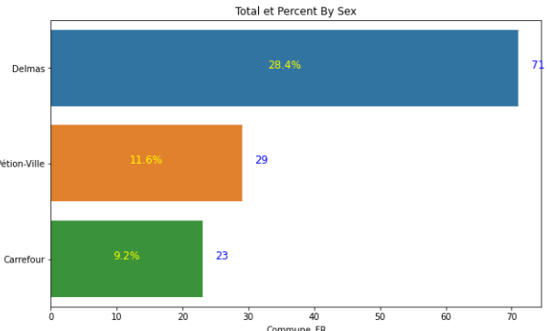
Results
Number of registration by Commune
This graph displays the names of the people registered in each commune. It shows us, apart from Port-au-Prince, the 3 other communes that have the largest number of registrants which are Delmas with a percentage of 28.4, Petion-Ville with 11.6% and Carrefour with 9.2%.

Slide 5
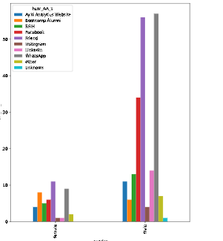
Hear Ayiti Analytics
This graph shows the three most effective channel who will allow a women to be susceptible to selection, there are are : Friends , WhatsApp , Bootcamp Alumni.

Slide 6
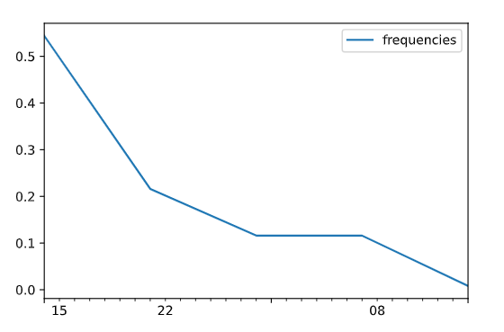
Registration date par commune
This graph shows us that at the beginning of the first launch of the cohort there was a lot of enrollment in the first week and from the second week the number of enrollees dropped and so on.

Slide 7
Methodology
METHODS, DATA SOURCES, AND CHOICE OF VARIABLES
DATA PROCESSING AND ANALYSIS USING PANDAS,MATPLOTLIB, SEABORN, NUMPY.
WE HAVE USED A DATA SET THAT CONTAINS INFORMATIONS ABOUT THE FIRST COHORT THAT TAKES PLACE AT PORT-AU-PRINCE
CALCULATIONS HAVE BEEN MADE ON THE NUMBER OF REGISTERED, PAYING AND ENROLLED PERSONS
AND CREATED FUNCTIONS FOR DATA ANALYZE.WITH PANDA NUMPY
WE USE MATPLOTLIB AND SEABORN TO MAKE THE GRAPHES

Slide 8
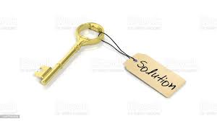
Discussion & Proposed Solution
After analyzing all the data we could see that less than 20% of girls have applied to this training center and we can have a much more excessive ratio. According to our analysis, the majority of candidates have access to their own equipment, i.e. a computer and an internet connection.
I highly recommmended Ayiti Analytics to implant theirs next data training center at : "Delmas , Pétion-Ville, Carrefour".

Slide 9
SOLUTION
STRENGTHS | Based on the choice of these communes: Delmas, Pétionville and Carrefour: -High percentage of students who have access to the internet at home. | Based on the choice of these communes: Delmas, Pétionville and Carrefour: -High percentage of students who have access to the internet at home.
WEAKNESSES | Given the insecurity in the country and the coronavirus, we risk facing a lack of high-speed internet connectivity in different areas: | -Lack of high speed internet connectivity in different areas -Difficulty for the teachers to teach the course in a given time | -Lack of progress at its own rate and poor assimilation of courses.
CHALLENGES | Apprehension du Numerique

Slide 10
References & Appendices
Ayiti Analytics data set
Google for the image

Slide 11
RECOMMENDATION
Based on the data from Ayiti Analytics the best way to learn is by direct practice of what we do and experimentation we recommend that the courses be much more practice oriented or using a simulator.

Slide 12
Present Team Member
Team Member: ketenie Flore Thénéus

